Slide 1


Slide 2


COVID-19 GAMETHON
Team Name: Hackathon Task
By
B. Jyothi
Disha Dhanrajani
Rohil Singh

Slide 3


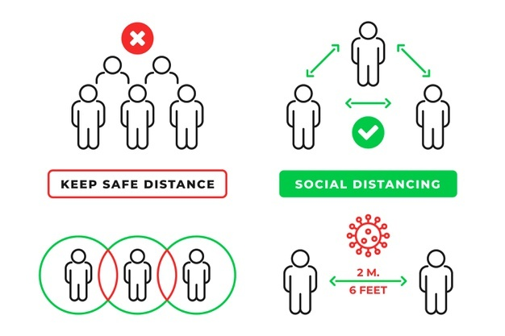
Introduction
Problem Statement
Idea: Methodology
Implementation
Duration, Budget & Scope
(Future work)
Results
Conclusion
References

Slide 4
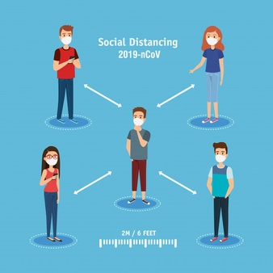
Introduction
Coronavirus disease 2019 (COVID-19) is a contagious disease
It causes by severe acute respiratory syndrome coronavirus 2 (SARS-CoV-2)
The COVID-19 predominantly causes as small droplets and aerosols containing the virus by transmitting from an infected person's nose and mouth as they breathe, cough, sneeze or speak
Common symptoms of Corona virus are:
Fever, Dry cough, Tiredness, Difficulty in
breathing, Headache, Sore throat,
Loss of taste or smell

Slide 5
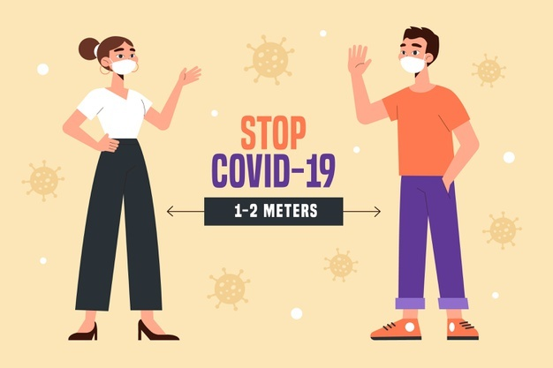
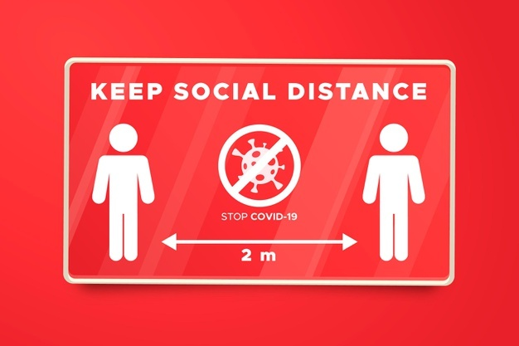

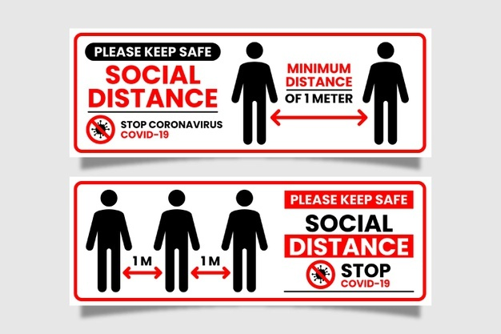
Preventive Measures
Prevention is better than Curing as Saying, one needs to take precautions from covid-19
Save your life & Others life
Wear a mask
Wash your hands with a soap
or a sanitizer
Maintain social distance
Avoid direct contact

Slide 6


Problem Statement
Challenges faced during uncertainty & pandemic situations
An analysis to assess the basic knowledge and self-expressed stigma regarding COVID-19 Outbreak among people
To provide awareness to all the game players

Slide 7


Idea: Methodology
To make the
Game as Contagious NOT the Virus/Disease
As Browsing, Sharing became Contagious in this Digital era, we need to use e-Content to provide the information to the public.
Planned, Designed & developed a Game
for implementation
Designing of a Logo with a
Tag Line as “Go Corona Go”
Synopsys is shown using Presentation

Slide 8
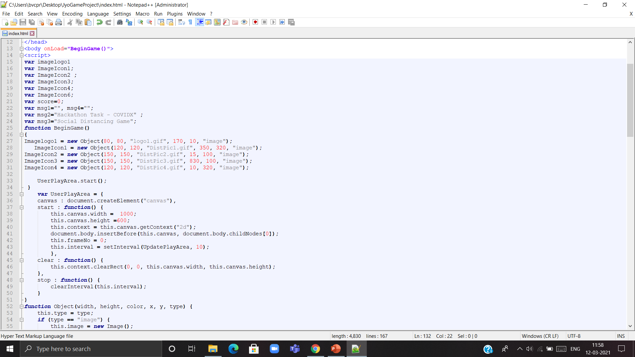
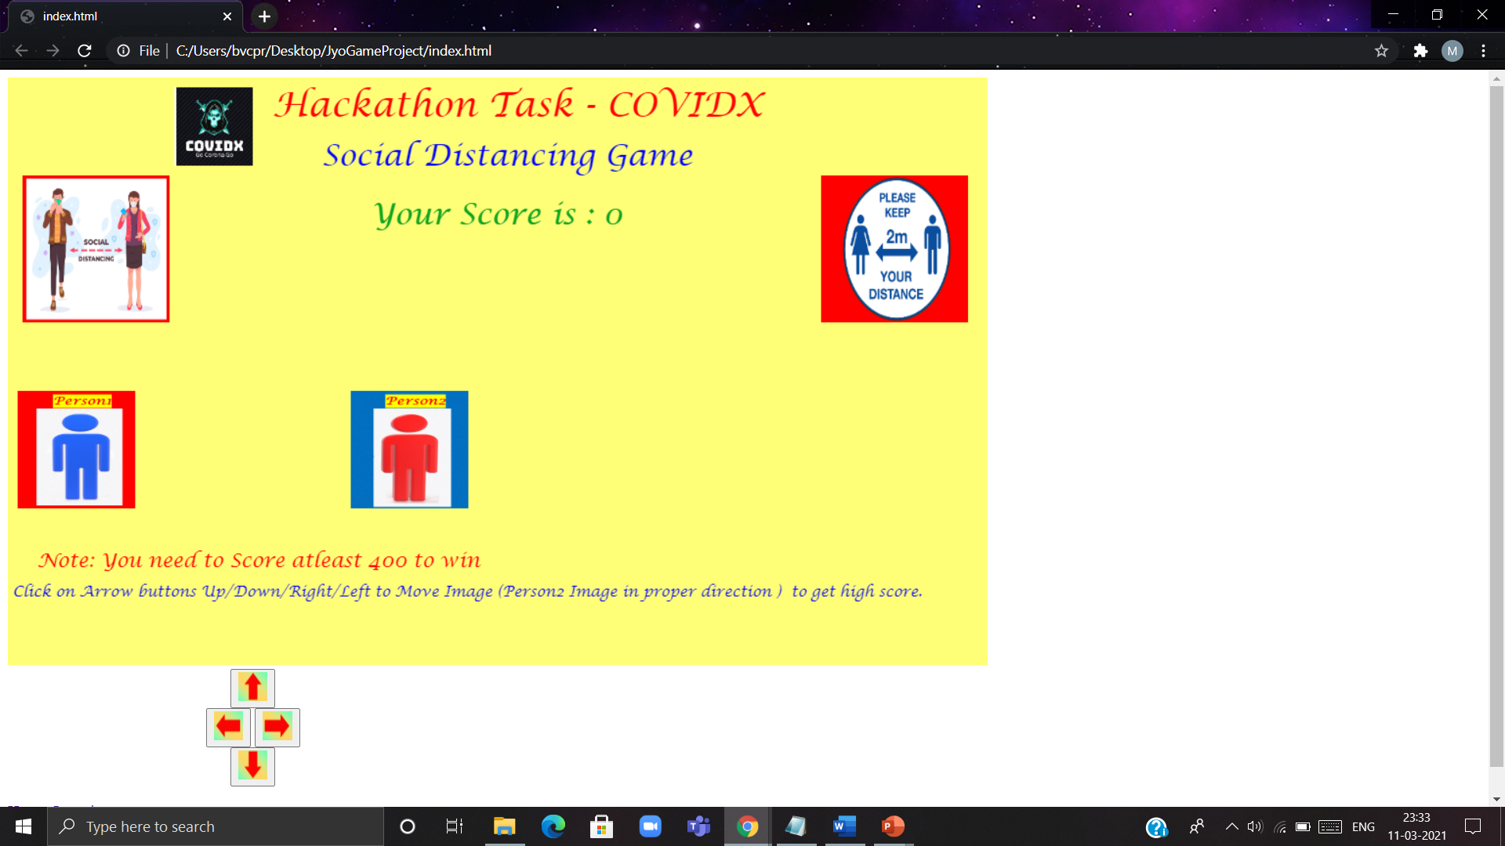
Implementation
Screenshots of Code & Output Game screen
Smart Phone is the Greatest Tool/Weapon for Smart Learning" - B. Jyothi

Slide 9
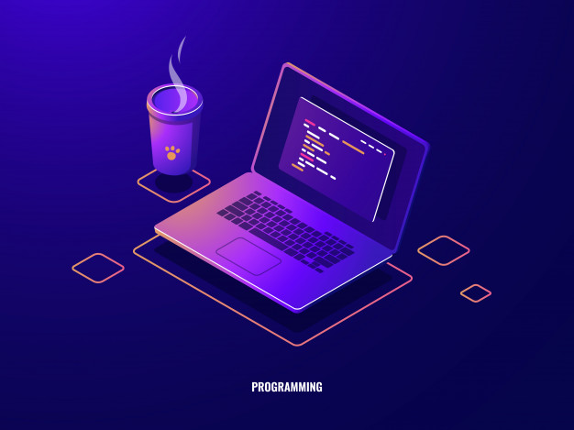
Click here for Playing a Game

Slide 10
Duration, Budget & Scope (Future Work)
S.No | Topic | Duration
1 | Planning the project | 12th Feb 2021 to 20th Feb 2021
2 | Designing/ Survey, Gathering Information & Designing Framework | 21st Feb 2021 to 27th Feb 2021
3 | Coding & implementation | 1st March 2021 to 8th March 2021
4 | Testing the Project | 9th March 2021 to 10th March 2021
5 | Submission of the Project | 11th March 2021 to 12th March 2021
Our Project can extend to many more levels for preventing/solving various issues (diseases, uncertain situations, Reducing corruption, Decreasing pollution by increasing greenery, environmental issues etc) to make India as Healthy India varying with the budget.
It is applicable for preventing various diseases.

Slide 11



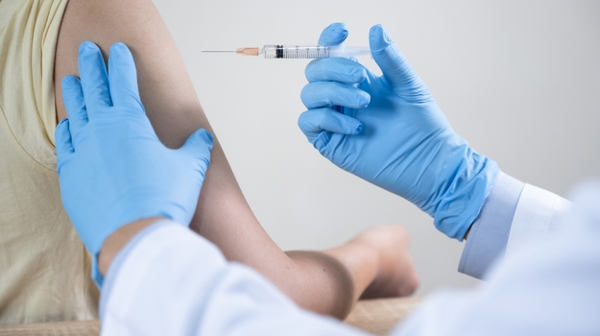
Results
Precautions were taken by the
individuals by awareness
Increased their Level of Immunity
Drive for Vaccination is on the go
It enhances the success and efficiency
of public health
(Cont..)

Slide 12
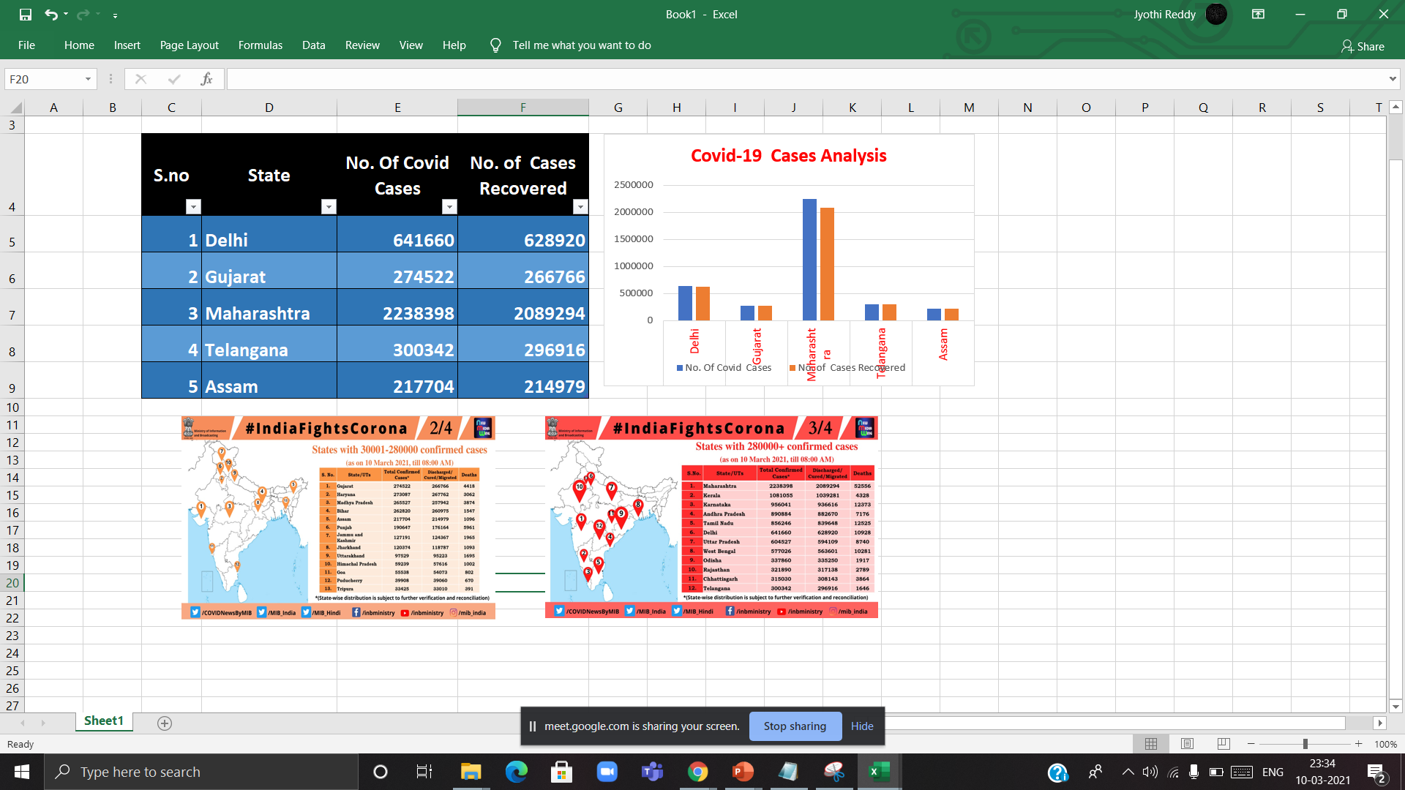
Statistical Analysis for Covid-19 Cases
Source: Data Collected from Official Government site & sample provided for few states

Slide 13
Conclusion
Our Project aims to provide awareness
It projects to learn with fun
As our logo says “Go Corona Go” one will be alert all the time by playing game
We want to make awareness through game among the younger age group to elderly people
Diseases and epidemic will never occur we can't denied that is just a beginning and occurs and then we will create games and making awareness
Pictorial representation is the best way to convey the message quicky & easily
Graphs & Charts can easily visualize and remember for a long period

Slide 14
References
https://www.cdc.gov/coronavirus/2019-ncov/index.html
https://twitter.com/COVIDNewsByMIB/status/1369537588512526336/photo/2
https://en.wikipedia.org/wiki/Coronavirus_disease_2019
https://www.freepik.com/free-vectors

Slide 15



